Slide 1








Social Media

Slide 2

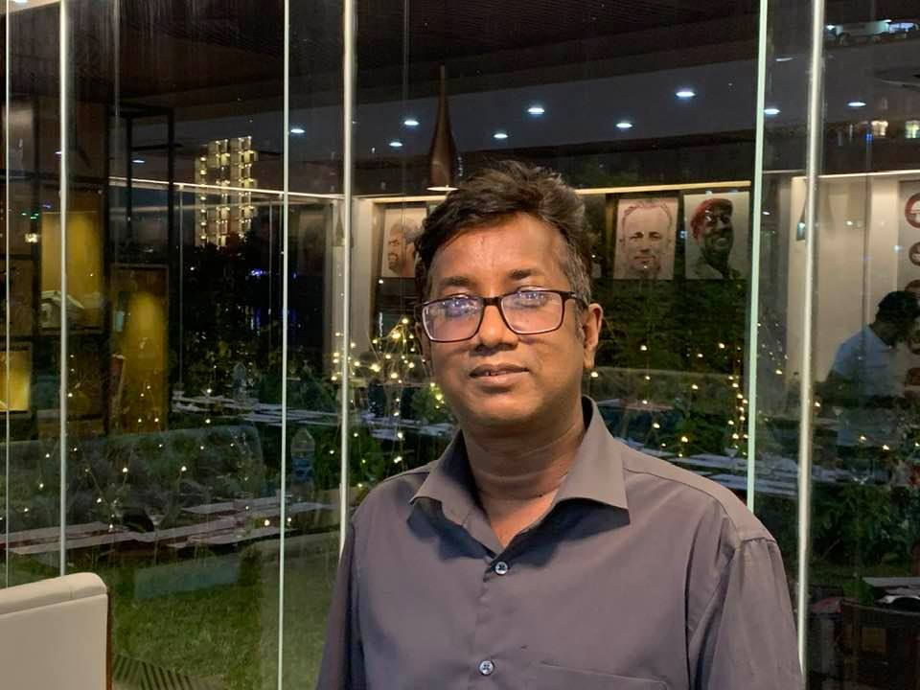
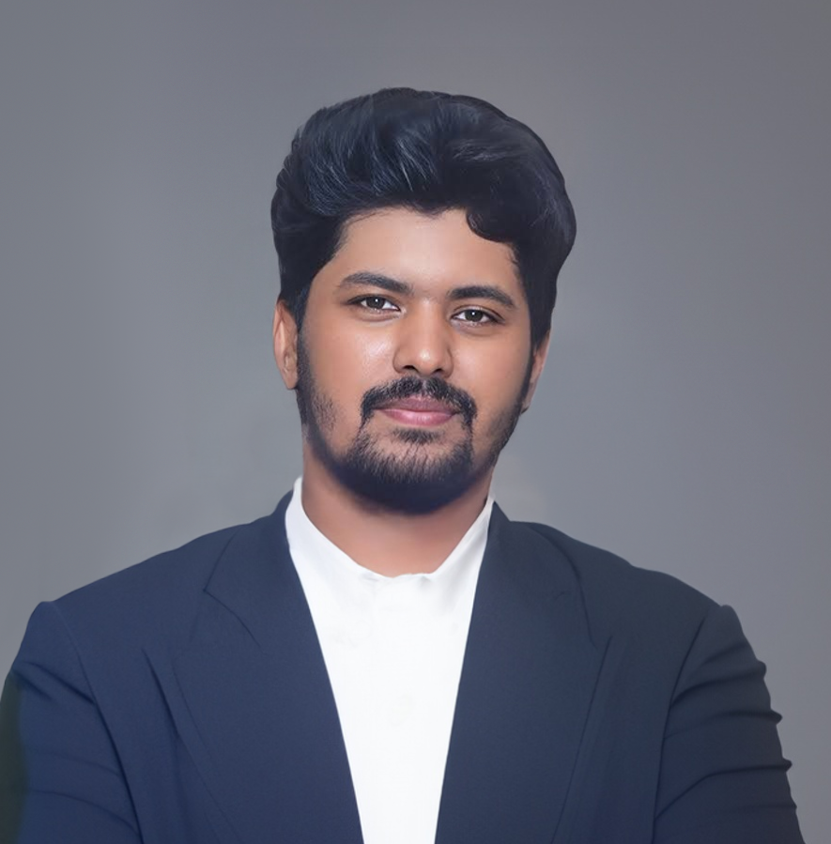
Farhana Lucky
Instructor
ID: 1272486
WDPF
ROUND: 54
Submitted to
Mohammad Moshaidul Islam
Consultant
IDB BISEW
Sheikh Rownakul Islam Miraj
Student
ID: 1272486
ROUND: 54

Slide 3
Index
INDEX OF PROJECT | Slide No.
Proposal Application | 4
Introduction | 5
Objectives | 6
Benefits | 7
Software Features | 8
Entity Relationship Diagram | 9
Software Flowchart | 10
Modules | 11
Timeline and Milestone | 12
Technical Information Source | 13
Use of Tools and Technologies | 14
Roles | 15
Methodology | 17
Example of Invoice Reports | 18
Forms Samples | 20
Conclusion | 22

Slide 4
Application
26th September, 2023
The Consultant
IDB Bhaban,
Sher e Bangla, Nagar, Dhaka
Subject: Project proposal letter for the Social Media system.
Dear sir,
Thank you for offering us a great opportunity to make a real life project based on our core course that is Web Development with PHP and Framework(WDPF). In this project, I would like to inform you that We have decided to make a project on Social Media System, which is most important for every social media owner. I have studied about the various aspects of the system and make a proposal accordingly which is enclosed here with for your kind perusal. So, We think you will finally Approved the project and help to utilize our creativity.
Sincerely,
Name: Sheikh Rownakul Islam Miraj
Batch: WDPF/NCLC-M/54/01
Round - 54

Slide 5
Introduction
The purpose of this project proposal is to present the development of a comprehensive Social Media system Application that will serve as a centralized solution for managing various aspects of your social operations.
I will aims to address the existing challenges in Messaging, post , groups.
This Social Media Management Application will offer a user-friendly interface and intuitive features, empowering your staff to efficiently handle messaging, groups, requests.
With a focus on automation and data-driven decision-making, this application will streamline processes, reduce manual errors, and enhance overall productivity.
By adopting this solution, your hostel will gain a competitive edge, as you will have real-time access to key performance indicators, enabling you to make informed business decisions promptly.

Slide 6
Objectives
Automate the process of booking management, including booking placement, tracking, and fulfillment.
Implement a centralized inventory management system for efficient tracking of booking levels, replenishment, and room and seat management.
Integrate robust reporting and analytics capabilities to gain insights into booking sales trends, hostel financial performance, and profitability.
Enhance security measures to protect sensitive customer and financial data.
Enable seamless integration with existing systems, such as accounting software and POS (Point of Sale) systems.
Provide user-friendly interfaces for easy navigation and quick adoption by store staff.
Offer scalability and customization options to accommodate future growth and evolving business needs.
Ensure compatibility with multiple devices, including desktops, tablets, and mobile devices, for on-the-go access to store management features.

Slide 7
Benefits
Increased accuracy and productivity in managing Social operations.
Real-time tracking and analysis of messaging and request data for informed decision-making.
Improved customer satisfaction through streamlined social management and messaging processes.

Slide 8
Software Features
Messaging Management:
Track messages , including message quantities, availability, and replenishment.
Set up low-online alerts and automated reordering processes.
Group manage and Tracking:
Capture social grouping, including payment post, comments, and likes.
Enable message status tracking .
Generate stats and slips for efficient social fulfillment.
Reporting and Analytics:
Generate real-time reports on messages, post levels, and progress.
Provide insights into top-performing Account, user beaviour patterns, and revenue trends.
Support customization and filtering options for tailored analysis.

Slide 9
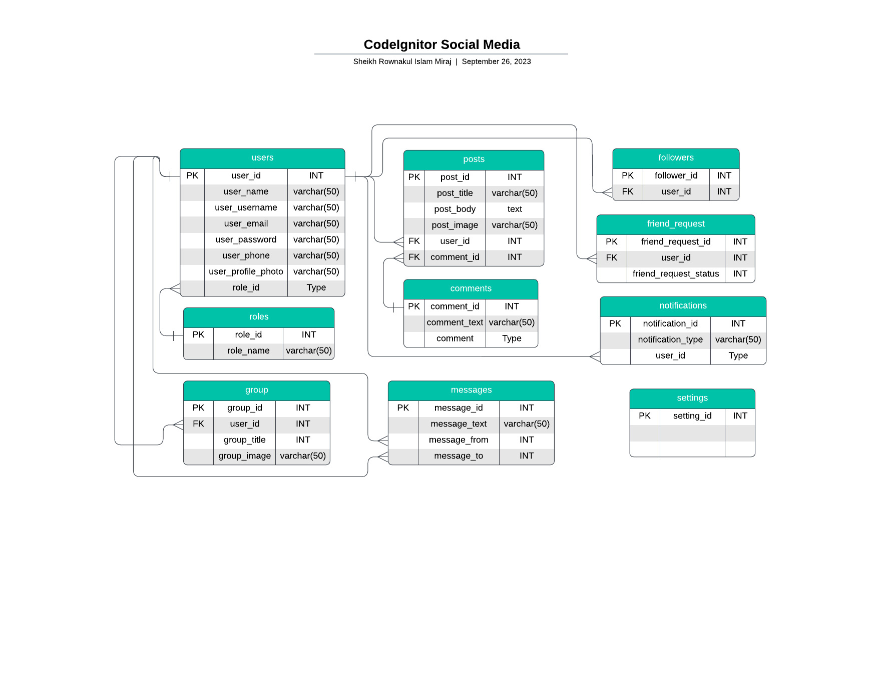
ERD – Entity Relationship Diagram

Slide 10
Software Flowchart
Create Account
Post
Comment
Message

Slide 11
Modules:
Messaging
Posts
Groups
SocialMedia
Friends

Slide 12
Timeline And Milestone:
Milestone | Duration (Days)
Requirements Gathering | 2
Design and User Interface | 5
Development and Coding | 15
Testing and Quality Assurance | 5
Deployment and Launch | 2
Project Completion and Handover | 1
Total Duration | 30

Slide 13
Technical Information Source:
Information Source | Description
PHP.net | Official documentation and reference for PHP programming language
MySQL.com | Official documentation and resources for MySQL database management system
W3Schools | Online tutorials and guides for web development technologies, including PHP and MySQL
Stack Overflow | Online community for programmers to ask and answer technical questions
GitHub Repositories | Open-source projects and code repositories for PHP and MySQL

Slide 14
Use of Tools and Technologies:
Tools and Technology | Description | Tools and Technology | Description
PHP | Server-side scripting language used for dynamic web development | jQuery | JavaScript library for simplifying HTML document traversal and manipulation
MySQL | Relational database management system for storing and retrieving data | Git | Version control system for tracking and managing code changes
HTML | Markup language for creating the structure and content of web pages | PhpStorm | Integrated development environment (IDE) for PHP development
CSS | Styling language for enhancing the appearance and layout of web pages | phpMyAdmin | Web-based administration tool for managing MySQL databases
JavaScript | Client-side scripting language for interactive and dynamic web functionality | Bootstrap | CSS framework for creating responsive and mobile-friendly web designs
React | Client side rendering, single page application | React - Router | Routing for single page applicant
CodeIgnitor | Server Side Api

Slide 15
Methodology
Agile Development Approach:
We will adopt an Agile development approach to provide flexibility and adaptability throughout the project lifecycle.
Agile emphasizes iterative development, collaboration, and regular feedback to deliver incremental value to stakeholders.
Our team will specifically follow the Scrum framework, which divides the project into sprints and emphasizes frequent communication and collaboration.
Design and Development Phase:
Our team will design the database schema and establish the necessary entity relationships for efficient data management.
We will develop the front-end user interface using PHP, ensuring an intuitive and user-friendly experience.
Back-end functionality, such as hostel management, sales order tracking, and reporting features, will be implemented using PHP and MySQL.
Extensive testing and quality assurance will be performed to ensure the reliability, security, and performance of the software.

Slide 16
Methodology
Collaboration and Communication:
Regular meetings will be scheduled among our team members to review progress, discuss challenges, and make necessary adjustments.
We will actively seek feedback from stakeholders and incorporate it into the development process to ensure their needs are met.
We will utilize project management and collaboration tools, such as task tracking systems and communication platforms, to enhance transparency and efficiency.
Continuous Improvement:
Throughout the project, we will conduct regular retrospectives to identify areas of improvement and implement necessary adjustments.
Feedback from end users and stakeholders will be highly valued and utilized to enhance the software's functionality and user experience.

Slide 17
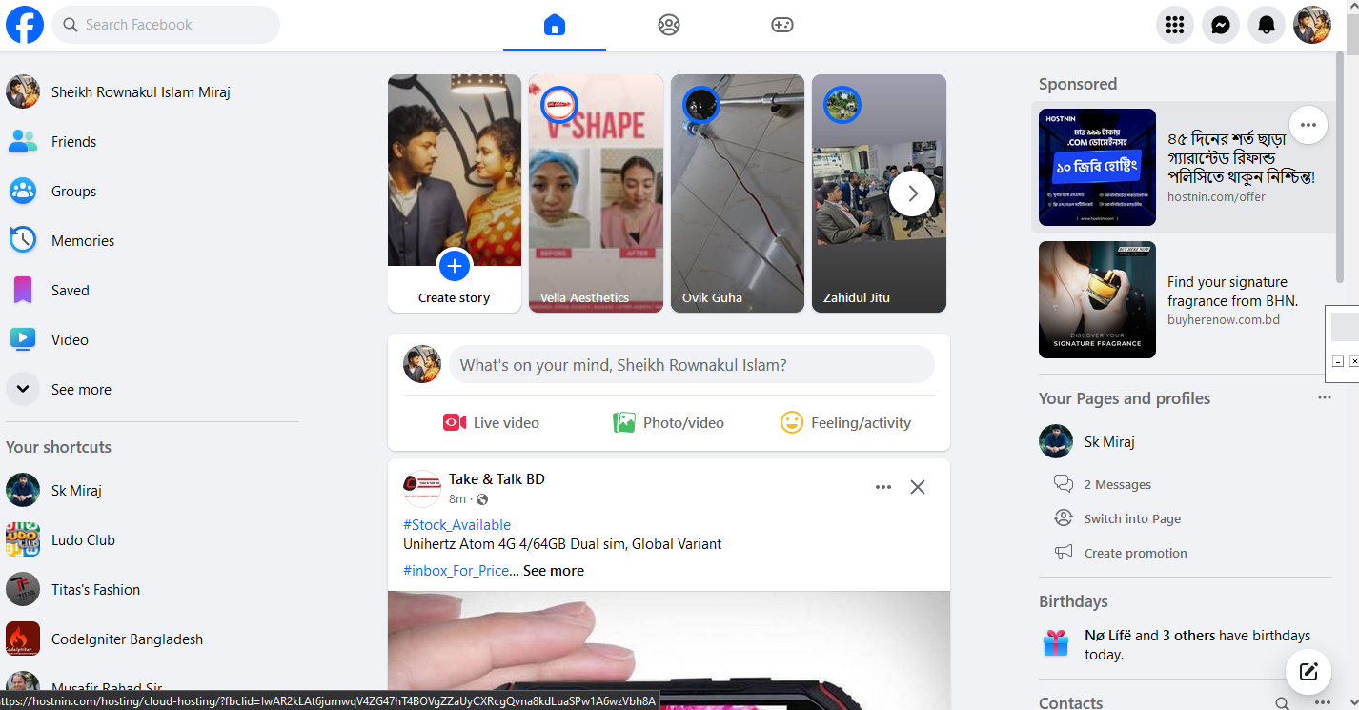
Web Frontend Design

Slide 18
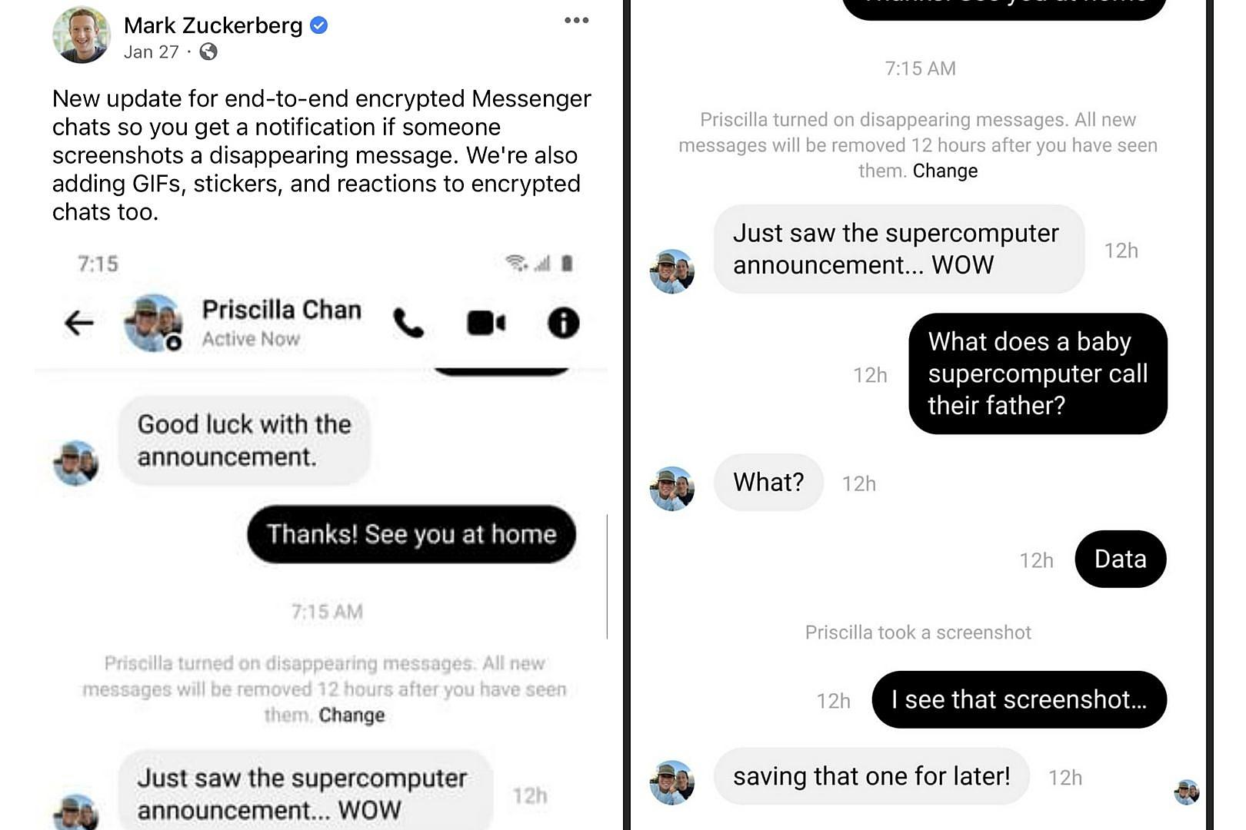
Example of Messaging

Slide 19
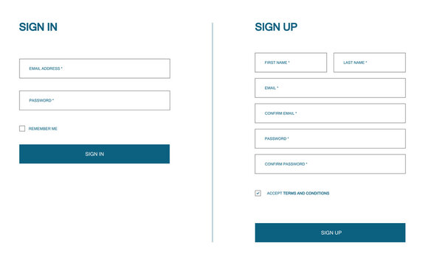
Form Sample

Slide 20
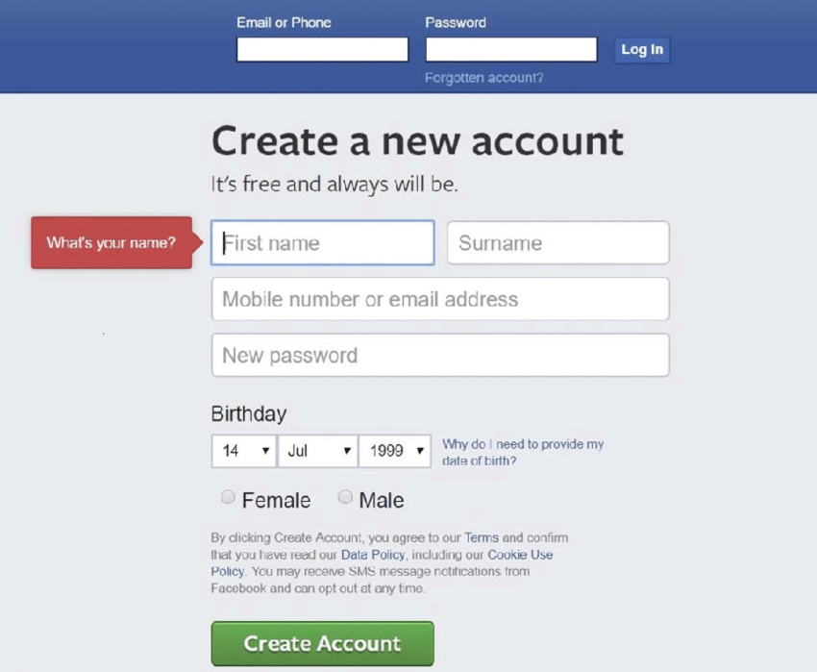
More Form Sample

Slide 21
Conclusion
Our Social Media management software proposal offers a comprehensive solution for efficient messaging and post management. With a well-defined Entity-Relationship Diagram (ERD) at its core, the software ensures seamless data organization and retrieval.
The ERD consists of interconnected tables such as “messaging," “post," “groups" “friends," “likes," “comment," “frontend," “loading," “stats," and “pakages" These tables facilitate various functionalities, including tracking product quantities, managing user roles, storing customer details, recording message, monitoring sales levels, categorizing buildings, and managing social interactions.
In summary, our social management software proposal empowers backend with efficient operations, optimized post control, and improved user satisfaction. It is a valuable tool for social of all sizes, aiding in their growth and success.

Slide 22
Thank You

